Slide 2
Find Your Business Ignite Power Session #3

Slide 3
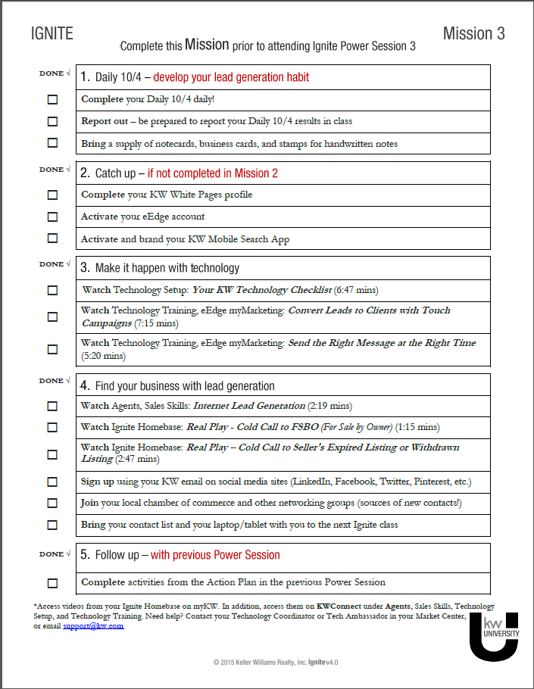
Let’s Get Started
Mission
Expectations
Action Reveal

Slide 4
Action Reveal
Contacts?
Notecards?
Laptop / Tablet?
Videos
What are your aha’s about lead generation?
What is the value of touch campaigns?
Takeaways that will help you in your business?

Slide 5
Daily 10/4
Your Lead Generation Habit
Daily!
Add 10 new contacts to your database.
Speak with 10 people in your database.
Write 10 notes.
Weekly!
Preview 10 homes.

Slide 6
Lead Generate
Your Turn, p. 8
Get out your call list—begin calls.
20 minutes

Slide 7
Handwritten Notes
Your Turn, p. 12
Write 2–3 notes.
5 minutes

Slide 8
Get Your Head in the Game
Lead Generation – It’s Job #1
“Success leaves clues: Agents who take Ignite achieve 71% more contacts, 65% more calls and 88% more previews. They grow their market share and create opportunities.”
-John Davis, CEO, Keller Williams Realty

Slide 9
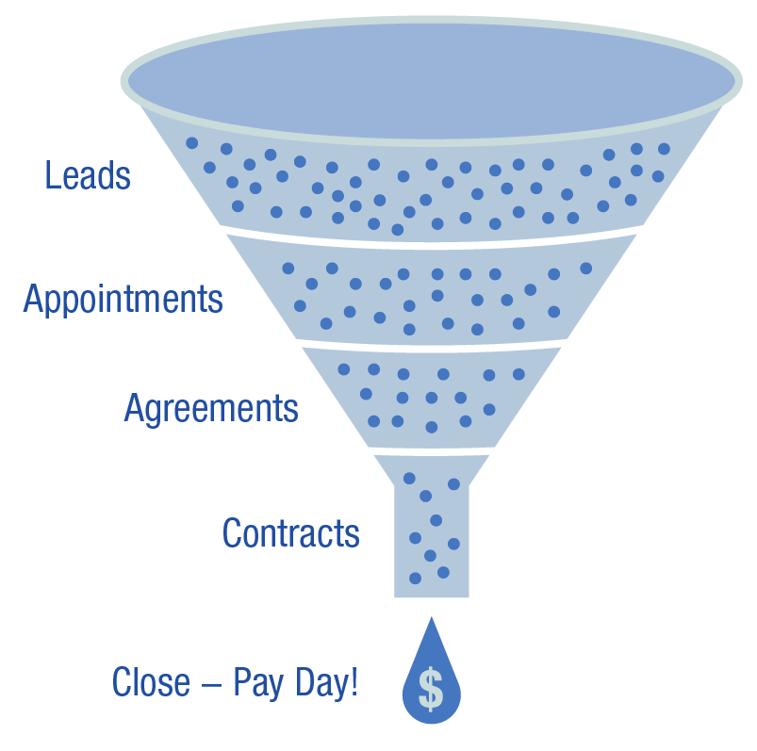
Make It Happen - Prospecting
Discuss question on p.16.

Slide 10
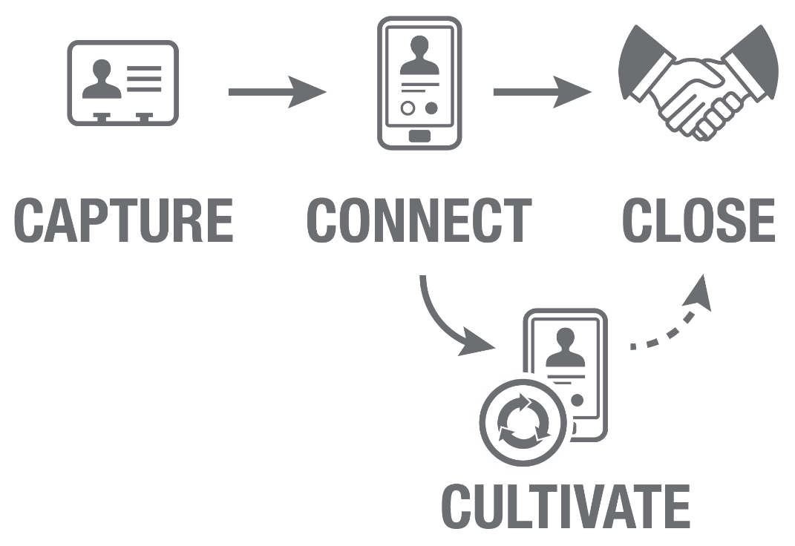
Four Cs of Prospecting

Slide 11
Your Sphere of Influence
All the people who know you, trust you, and may do business with you.

Slide 12
Sphere of Influence
Your Turn, p. 24
Fill out your Sphere of Influence.
10 minutes

Slide 13
Time-Blocking
Watch Video: “Cold Calling with the Real Estate Brothers”, p. 23
5 minutes

Slide 14
Prospecting Opportunities
Discuss prospecting opportunities.
Watch Video: “Finding More Leads”, p. 25
5 minutes

Slide 15
Prospecting Sources
Your Turn, p. 36
Post to social media.
10 minutes

Slide 16
Become a Lead Generation Machine!
“My fear of failure was greater than my fear of lead generating.” – Gary Keller

Slide 17
Putting It All Together
Action Plan
Prepare for Your Next Class
Recall and Remember
From Aha’s to Achievement
Achievements of the Week
Enhance Your Learning

Slide 18
Find Your Business Ignite Power Session #3

