Slide 2
Ignite Your Business Ignite Power Session #1

Slide 3
Welcome to Ignite!
Get Your Head in the Game
Discuss questions on p. 7
You’re in Business!

Slide 4
Six Personal Perspectives
Self-Mastery
80/20 Principle
E to P
Mindset
Approach to life
Attitudes
Learning-Based
No Limiting Beliefs
Accountable

Slide 5
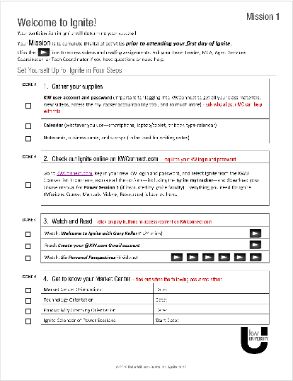
Getting the Most from Ignite
Getting the Most Out of This Experience
Action Reveal
Mission
Expectations
Ground Rules
Mission

Slide 6
Action Reveal
KW Email address?
Notecards?
Ignite page on KWConnect?
Videos
What is the ONE way Gary Keller says it takes to achieve success in real estate?
What are some of the habits of high-performing agents?
What are your aha’s about KW technology?

Slide 7
Big Why
Your Turn, pp. 19-22
Write out your personal Big Why.
15 minutes

Slide 8
Monetary Goal
Your Turn, page 23-26
Calculate your goal
5 – 10 minutes

Slide 9
Lead Generation
“For every day you don’t lead generate, 90 days later you can expect no money! You don’t want this to happen.”

Slide 10
Lead Generation
Discuss questions on p. 28.

Slide 11
Daily 10/4
Your Lead Generation Habit
Daily!
Add 10 new contacts to your database.
Speak with 10 people in your database.
Write 10 notes.
Weekly!
Preview 10 homes.

Slide 12
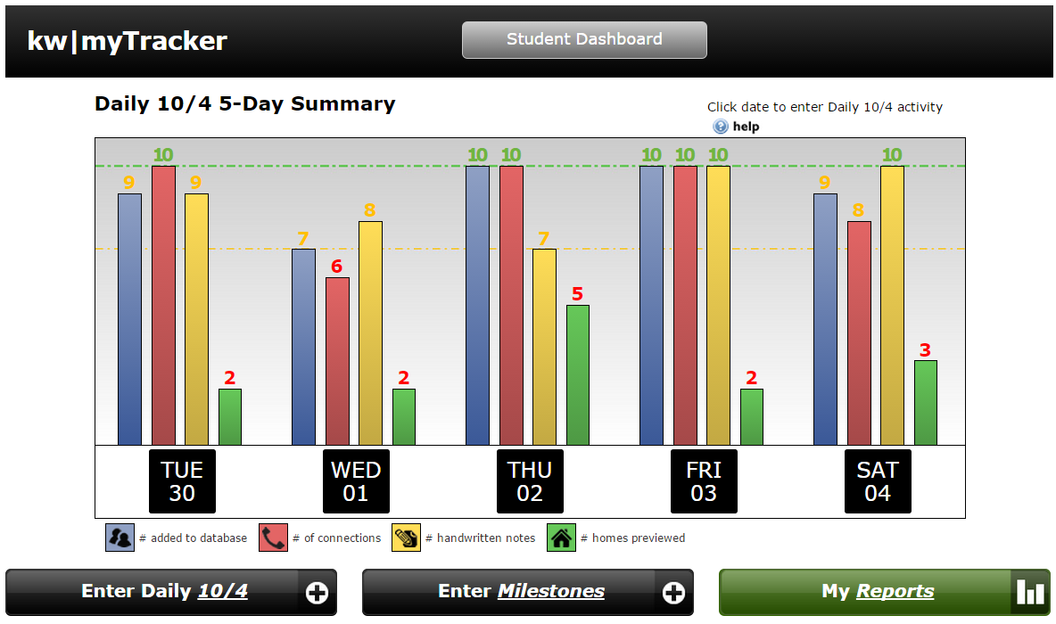
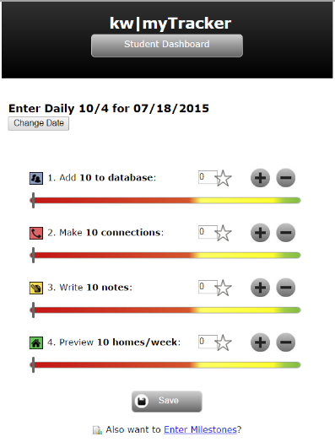
Ignite myTracker – Daily104.com
Help
Enter
Try It Now!

Slide 13
Sales Language
Scripts
Watch video – “How to Use Scripts” p.37
Scripts are one way to move you from E to P. All top agents use scripts, and practice them daily!

Slide 14
Sales Language
Your Turn, p. 41
Practice scripts
5 minutes

Slide 15
Your turn! Make calls 1. Get referrals 2. Share your App 20 minutes
Reminder: Comply with federal and state Do Not Call (DNC) and spam laws and the policies of your local Market Center.

Slide 16
Daily 10/4
Your Turn, p. 46
Write personal notes.
5 minutes

Slide 17
Be Accountable
What is the ONE Thing I can do such that by doing it everything else will be easier or unnecessary?
Your Turn, p. 50
Prioritize tasks

Slide 18
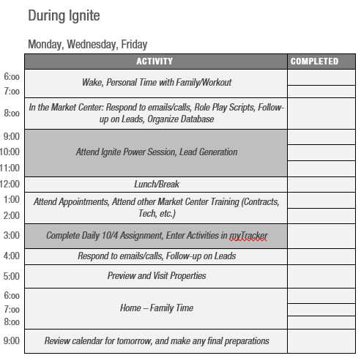
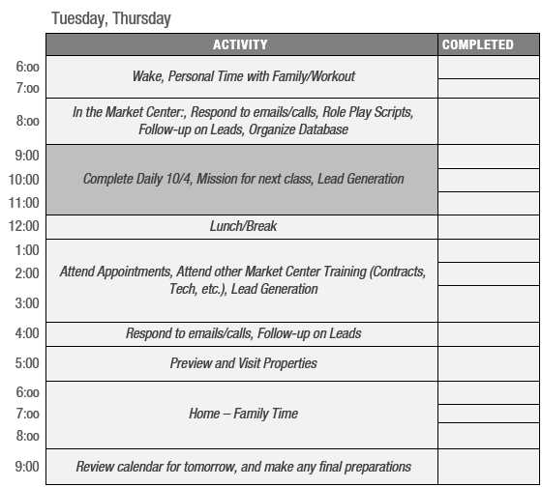
Live By Your Calendar

Slide 19
Live By Your Calendar
Your Turn, p. 55
5 minutes

Slide 20
Accountability Partners
Coaching/Mentoring
Success Partners
Personal Accountability

Slide 21
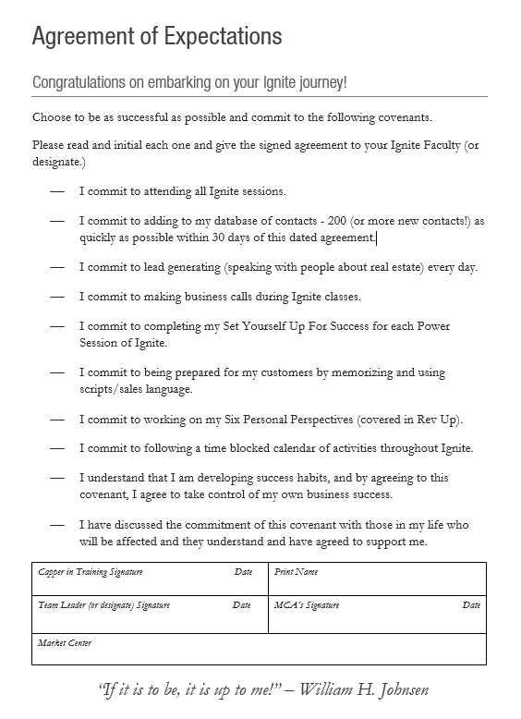
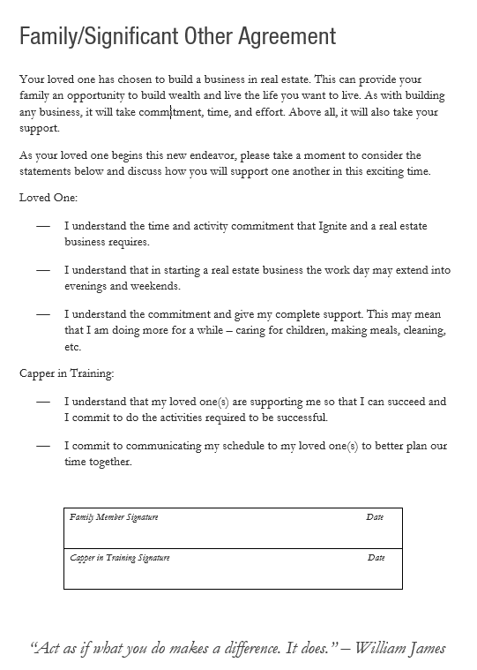
Agreement of Expectations

Slide 22
Putting It All Together
Action Plan
Prepare for Your Next Class
Recall and Remember
From Aha’s to Achievement
Enhance Your Learning

Slide 23
Ignite Your Business Ignite Power Session #1

